Slide 1
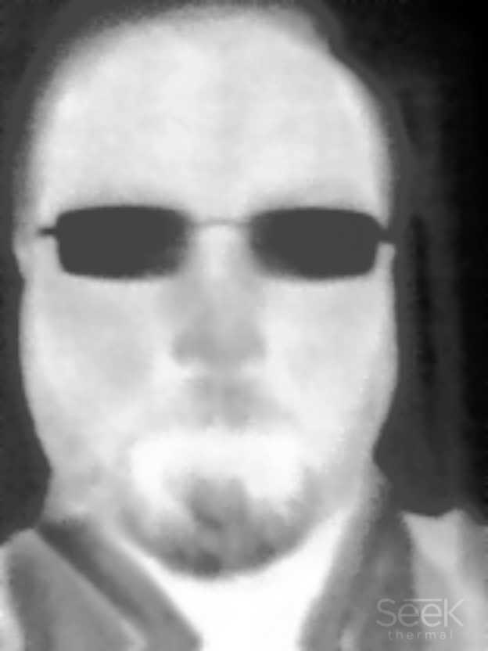
A Review of Thermal IR Imaging
Ellis Freedman
Serious Science, LLC
November 7, 2022

Slide 2
IR Imagery Provides Information Unavailable in Visible Imagery
Heat loss or suppression
Short term variations over time
Power generation or activity
Hidden or covert activities
Easy water detection
Absolute temperature estimates
Vegetation evapotranspiration

Slide 3
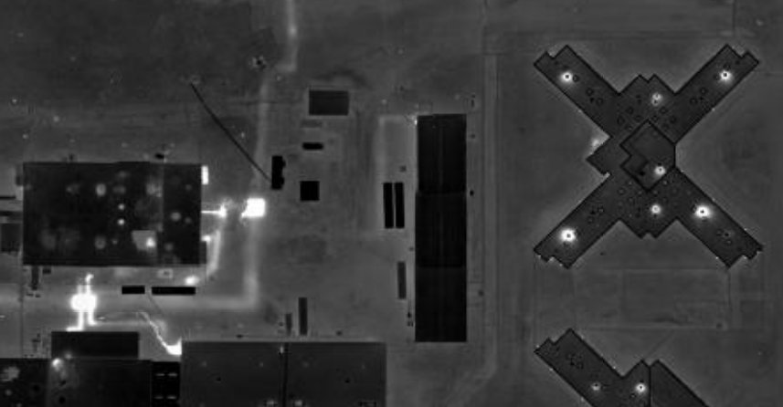
Heat Loss
Prison
Heat Vents
Temperature estimates from the image and weather data enable the estimation of BTU loss
(All images courtesy of Stockton Infrared Thermographic Services (www.stocktoninfrared.com)

Slide 4
Hidden Activity
Underground steam pipes
(All images courtesy of Stockton Infrared Thermographic Services (www.stocktoninfrared.com)

Slide 5
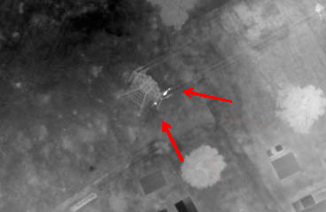
Power Generation
Hot spots on a high voltage transmission line
(All images courtesy of Stockton Infrared Thermographic Services (www.stocktoninfrared.com)

Slide 6
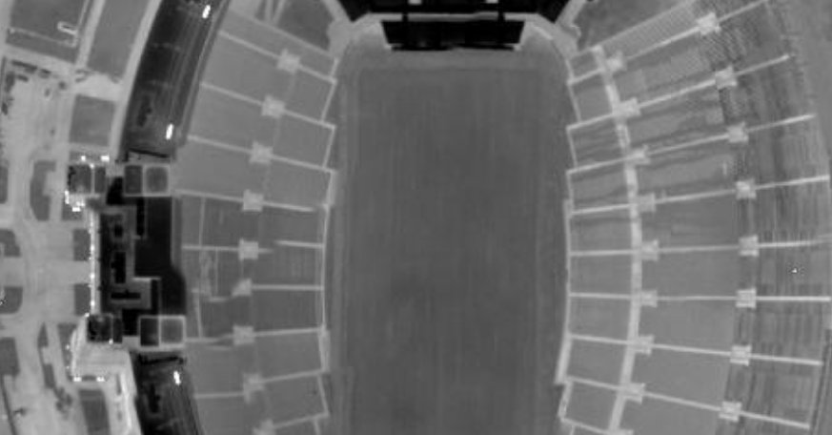
Otherwise, Non-Visible Activity
Empty Stadium
Office Activity
Entrance Lights
(All images courtesy of Stockton Infrared Thermographic Services (www.stocktoninfrared.com)

Slide 7
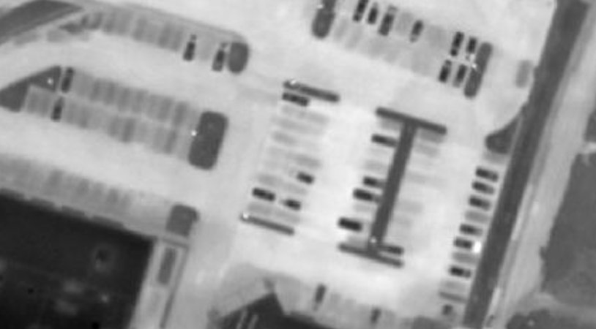
Temporal Activity
Truck Depot
Truck with idling engine
Spots where trucks used to be
Current trucks
Temperature estimates from the image, surface models, and weather data allow the
derivation of the time since the vehicle left
(All images courtesy of Stockton Infrared Thermographic Services (www.stocktoninfrared.com)

Slide 8
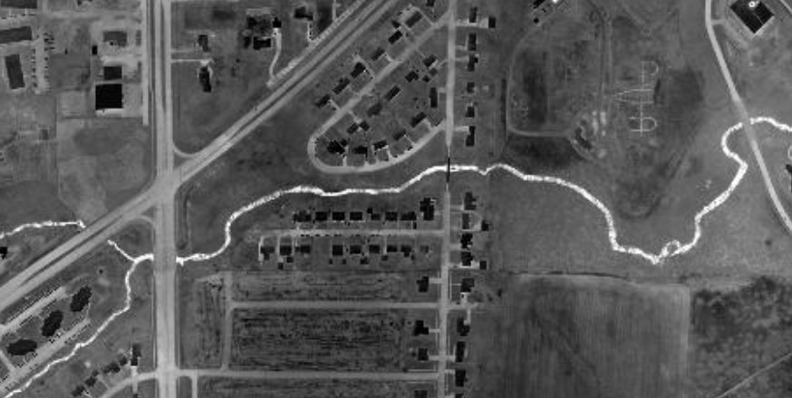
Open Water Detection and Tracking
Stream winding through housing developments and under roads
(All images courtesy of Stockton Infrared Thermographic Services (www.stocktoninfrared.com)

Slide 9
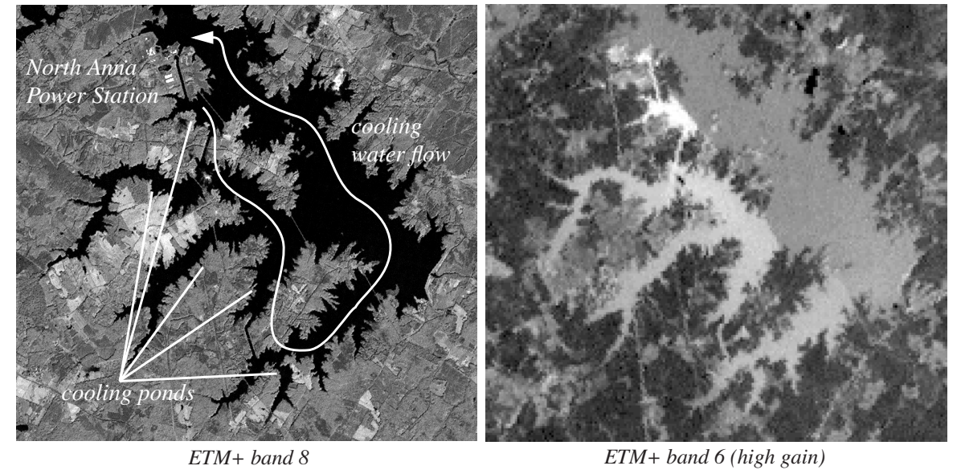
Lake Anna, VA Power Plant
Thermal IR sees the warm water generated by the cooling of the nuclear power plant

Slide 10
New Orleans, LA
Landsat ETM+ Pan Band (Band 8)
Landsat ETM+ Thermal Band (Band 6)

Slide 11
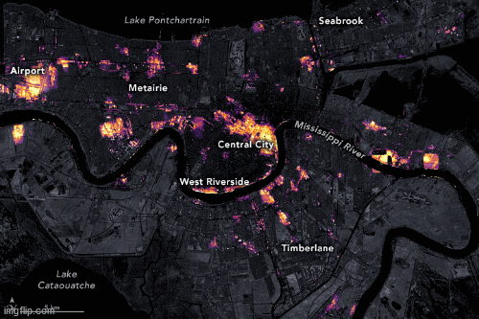
New Orleans, LA Before and After Hurricane Ida

Slide 12
Evapotranspiration
The rate at which plant life loses water through evaporation or soil drainage
Vitally important for agriculture in light of climate change
Traditionally done with a lysimeter
Plants are kept in a container, water drainage is measured and the plant and soil weight is measured over time
Wide area measurements can be performed with remote readings of absolute temperature

Slide 13
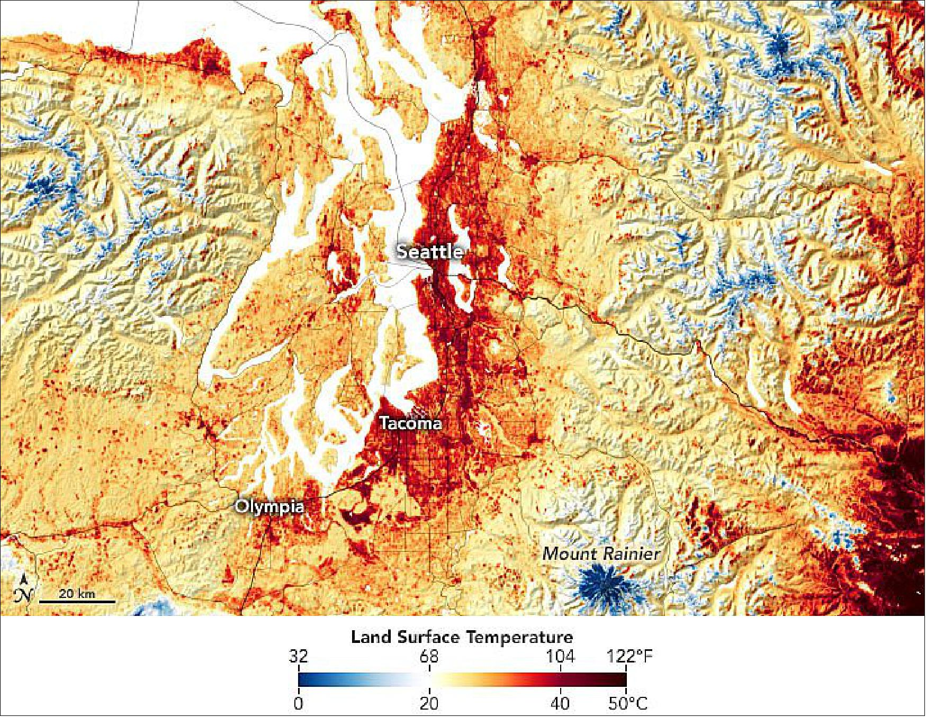
Land Surface Temperature Map of Seattle and Environs

Slide 14
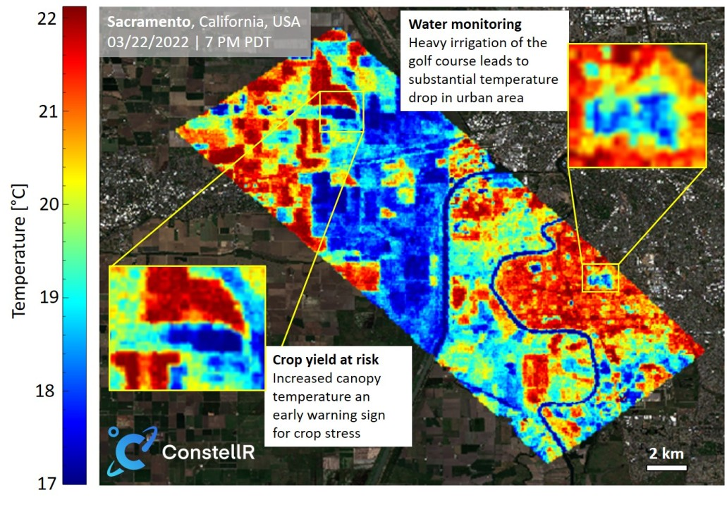
Crop Stress in Sacramento

Slide 15
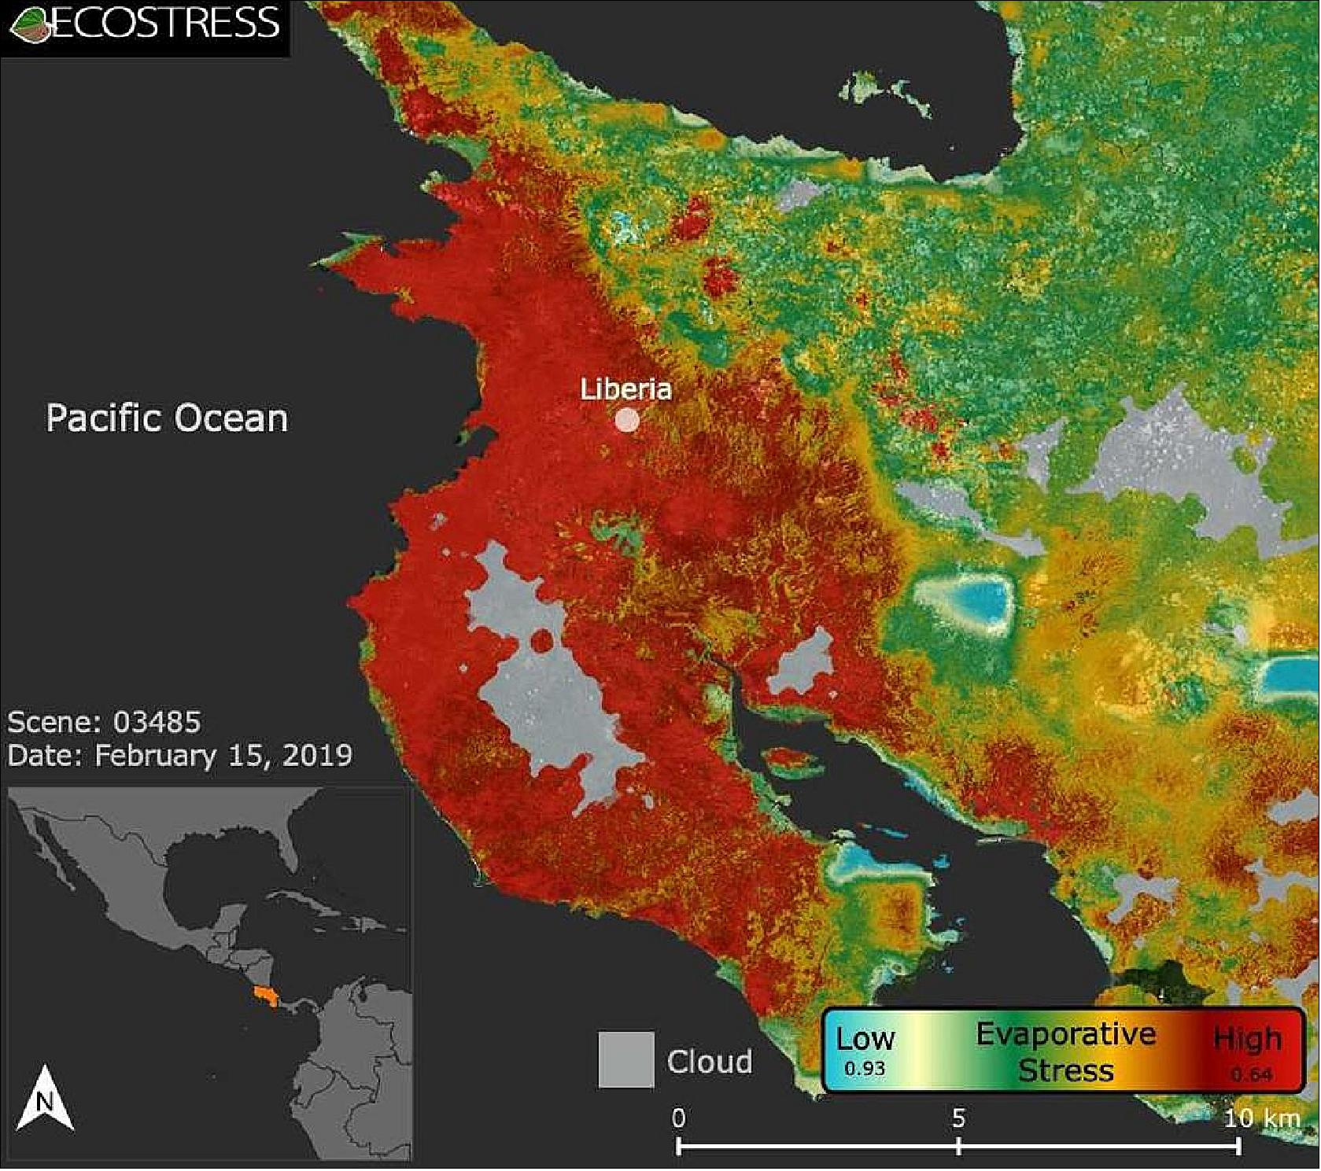
Evapotranspiration Stress on Crops in Costa Rica

Slide 16
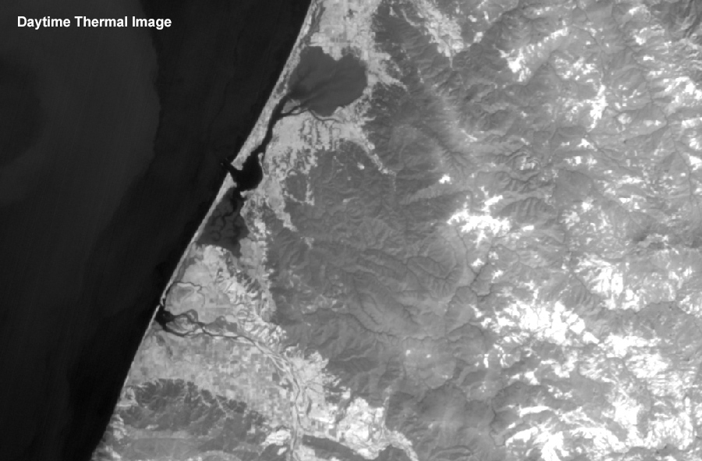
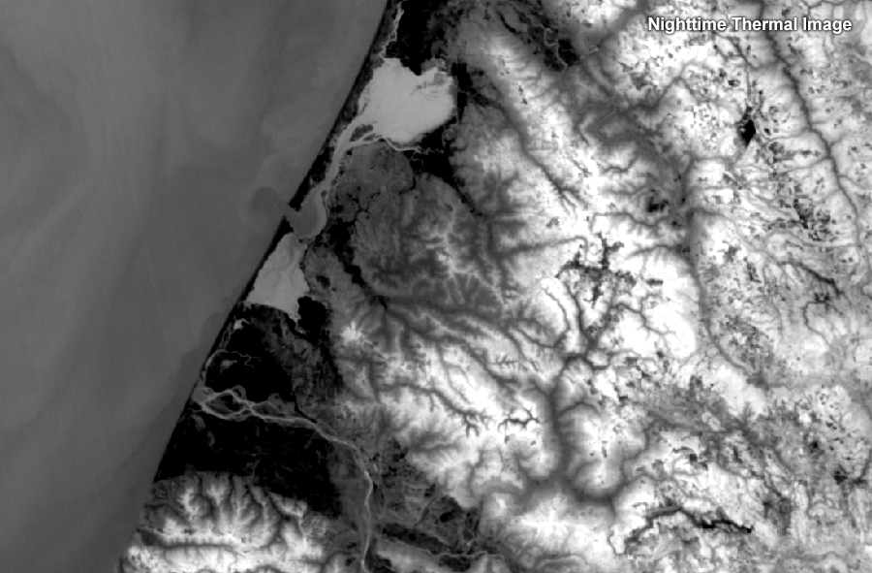
Day Night Variations
Water generally appears cooler in the daytime thermal images and warmer in nighttime imaging.
Trees generally appear cooler during the day and warmer at night.

Slide 17
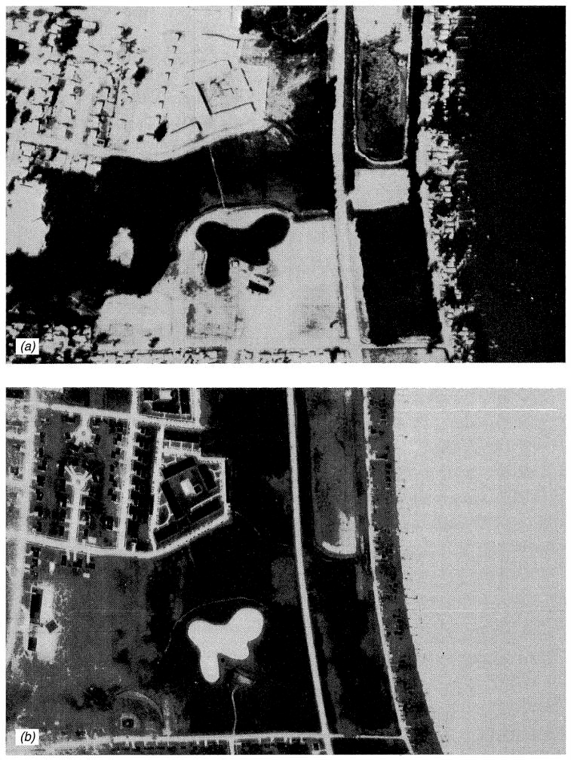
Diurnal Temperature Variation
Middleton (WI), USA
Daytime
Paved areas appear relatively warm during the day and night. Pavement heats up quickly and to higher temperatures than the surrounding areas during the day and loses heat relatively slowly at night.
Nighttime

Slide 18
What IR Imagery Isn’t
A spatial or visual competitor for visible imagery
IR senses thermal phenomenology in a contextual format
It can be registered, overlaid and sharpened with visible images to provide better context, geospatial and geodetic accuracy
High resolution panchromatic is > 20X better resolution
In general, civil/scientific imagery is useful for thematic or climatic evaluations, not for sensing most manmade objects

Slide 19
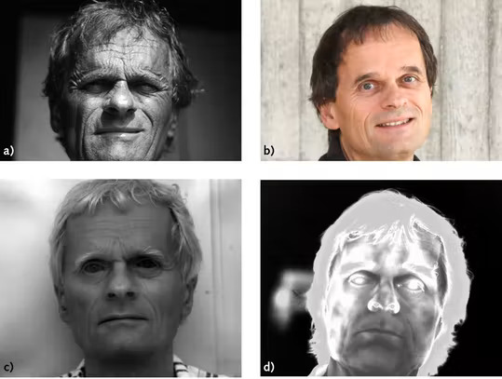
Image Comparison Under Different Light Wavelengths
(a) UV light, (b) visible light, (c) SWIR light, (d) MWIR light

Slide 20
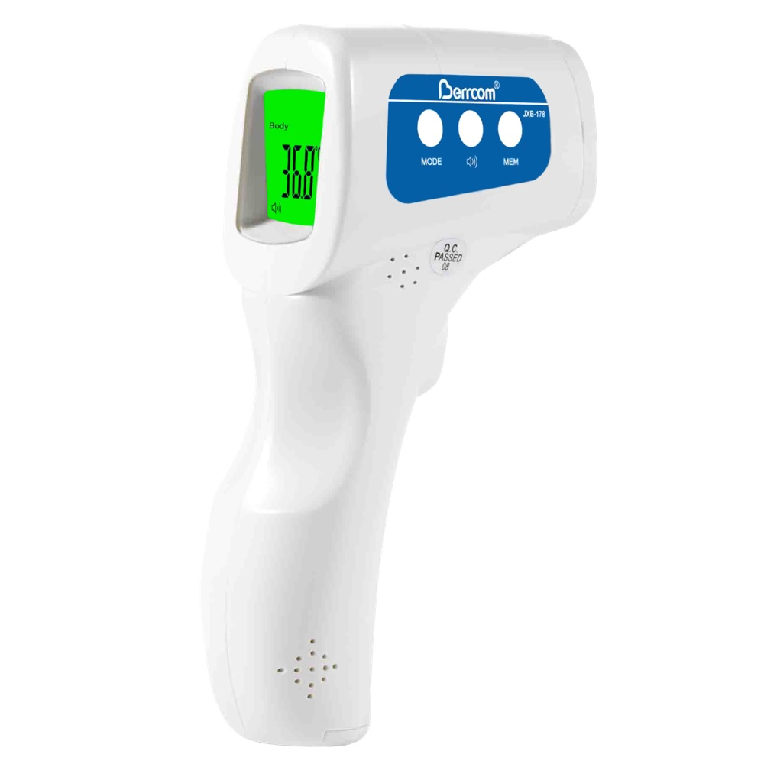
The Equations for Thermal IR Are Similar to Those for Visible
GSD, resolution, etc. are the same
Different detectors and optics are used
Some are photoelectric, as in the visible
Instead of silicon, they can be made of mercury/cadmium/tellurium (MerCad), Indium/ Antimonide (InSb) or indium/gallium/arsenic (InGaAs) depending upon wavelength
Some are not (microbolometers, pyrometers, etc.)
Bolometers change resistance with temperature and have slower responses than other sensors.
These are used in non-contact thermometers
Glass and many plastics are opaque to thermal IR
Need more exotic materials, like germanium or zinc selenide

Slide 21
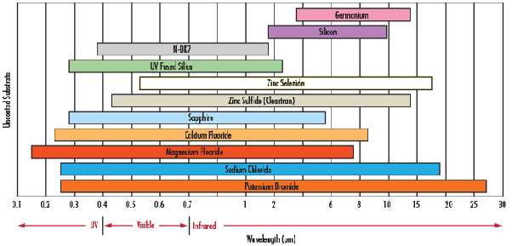
IR Requires Different Materials for the Optics
Thermal

Slide 22
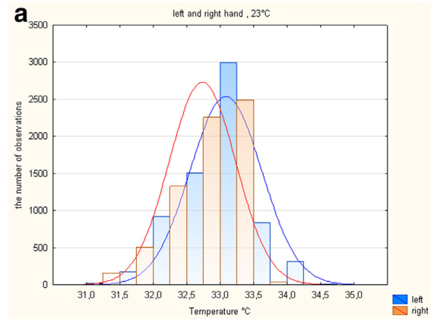
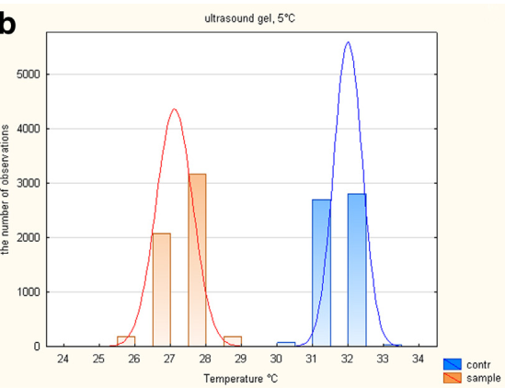
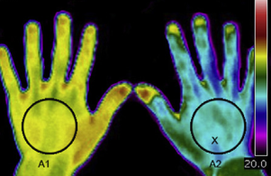
Determining Temperature Remotely Requires Knowledge of the Target Emissivity
Variability of Skin Emissivity Causes Significant Errors in Temperature
Clean Hands, Left and Right
Clean Hand vs. Hand with Ultrasound Gel
Simplistically, if temperature is related to sensed radiance by,
$$T={\left(\frac{Radiated Power per Unit Area}{εσ}\right)}^{1/4}$$
then a 1% error in emissivity creates a 1.4F error in temperature.

Slide 23
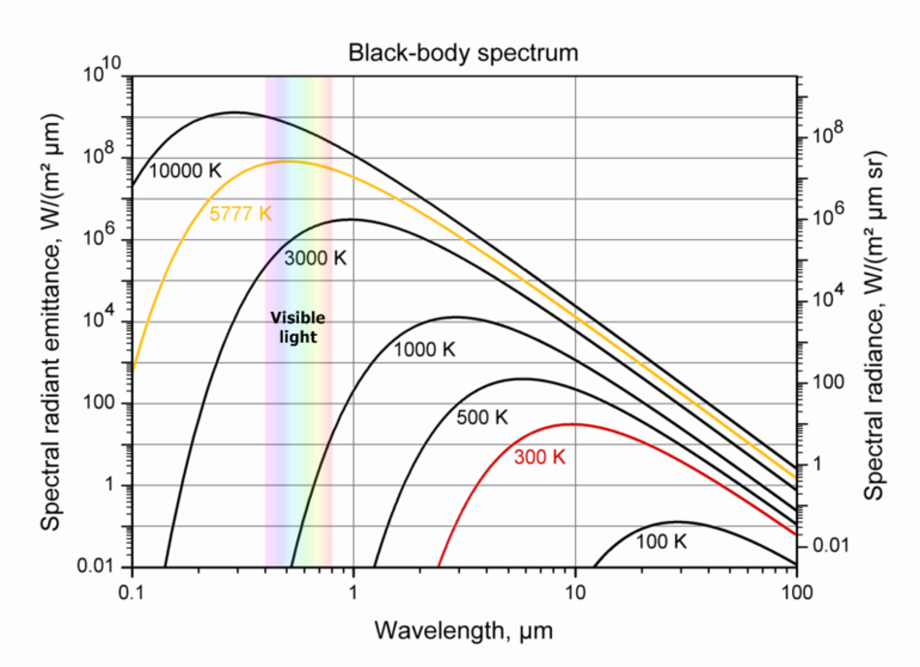
Everything Radiates
Typical Thermal Bands
Average temperature of the earth is 287K.
That’s why most thermal cameras are sensitive in the range of 8um to 14um.

Slide 24
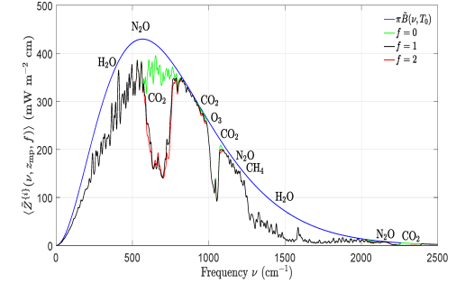
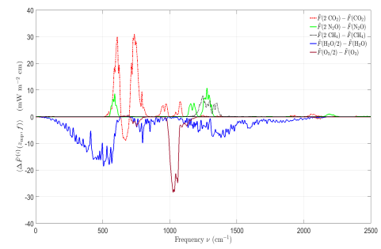
How Greenhouse Gases Increase the Earth’s Temperature
20um
10um
5um
Upward Flux
∆ Upward Flux

Slide 25
Thermometry vs. Radiometry
Radiometry is the measurement of the radiance (brightness) of a large area.
Thermometry is the measurement of the temperature of an object.
For each, there are absolute and relative measurements.
Absolute radiometry or thermometry is the quantitative measurement of something on an absolute scale
E.g. 98.6F, not warmer than something else.
Relative radiometry or thermometry is the quantitative measurement of the difference between one object and another in the same or different scene
E.g. water near a reactor in a cooling pond is 2.2C than water at the far end of the pond.

Slide 26
Absolute Temperature Estimates
Absolute temperature measurements are not necessary for detection of activity
It is necessary for quantitative evaluations
BTUs
Power loss estimates
Time since a vehicle has moved
Absolute temperature requires absolute radiometric calibration

Slide 27
What is Calibration?
If A = B and B = C, then A = C
If a camera produces the same pixel values when looking at an object with an unknown temperature as when looking at an object with a known temperature, then the unknown temperature is the same as the known temperature.
Blackbody calibrator with known temperature
Thermal Camera
Calibration is done periodically to account for changes over time.
Mirror

Slide 28
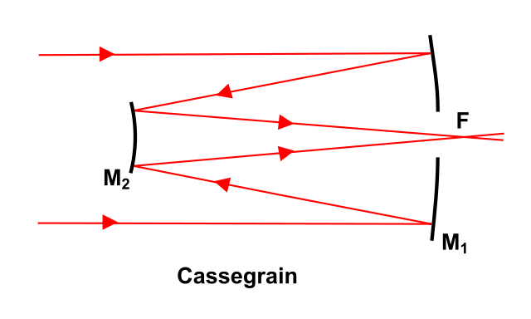
Absolute Temperature Calibration Requires a Combination of Things
On-board blackbody calibrator (i.e. a calibrator built into the camera)
Vicarious ground calibration
Accurate accounting of all thermal radiance sources, such as nearfield (self emission from telescope/sensor) calibration
If a photoelectric detector senses heat, and the inside of the camera is warm, the total power on the detector will create a bias and increase the noise
Microbolometers can display bias, but don’t suffer from additional noise.

Slide 29
Potential Sources of Revenue
Detection and assessment of power generation and transmission problems
Problem power lines and transformers will be highlighted
Detecting the activity of vehicles and aircraft
Parking lot and airport activity
Are mall customers continuously shopping or did the mall only see activity early in the day?
Which cars and aircraft are running their engines?
Large scale estimation of energy efficiency in large buildings and factories
Determination of nighttime activity vs. daytime
Mapping of underground steam pipes and other activities
Theft of natural gas
Easier mapping of rivers, streams flooding and runoff
Rapid and detailed mapping of fires
Monitoring of illegal burn exhausts
Animal and human detection and location
Military, security and intelligence
Crop improvement

Slide 30
Summary
Thermal imagery has valuable utility for many missions
It can be combined with other sources of imagery to provide a better GIS solution
It provides information unavailable from visible cameras, but at lower resolutions.
Equations for the design and performance of thermal cameras are similar to those of other cameras, but require some additional information.
Well established technologies are available for the cameras.

