Slide 1
Imaging Satellites
Ellis Freedman
Serious Science, LLC
October 24, 2022

Slide 2
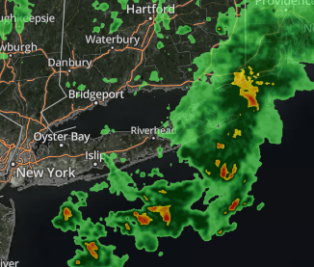
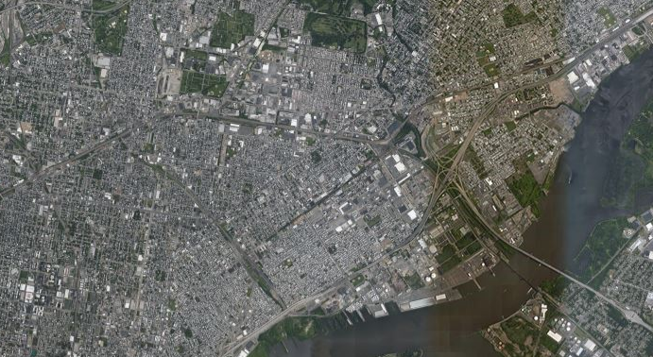
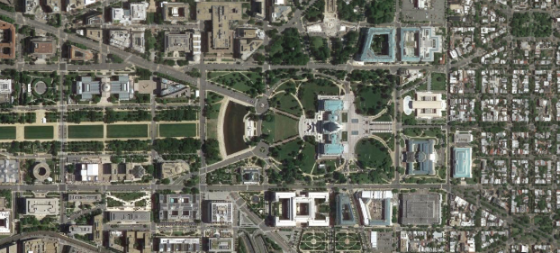
Images from Satellites Are Ubiquitous
Microsoft Bing
Weather Satellites
Google Earth

Slide 3
Types of Imaging Satellites
Optical
  Visible
    Panchromatic
    Color
  Multispectral
  Hyperspectral
  Video
  IR / Thermal IR
Radar
  SAR
  ISAR
Other
  Sounders
  Gravity

Slide 4
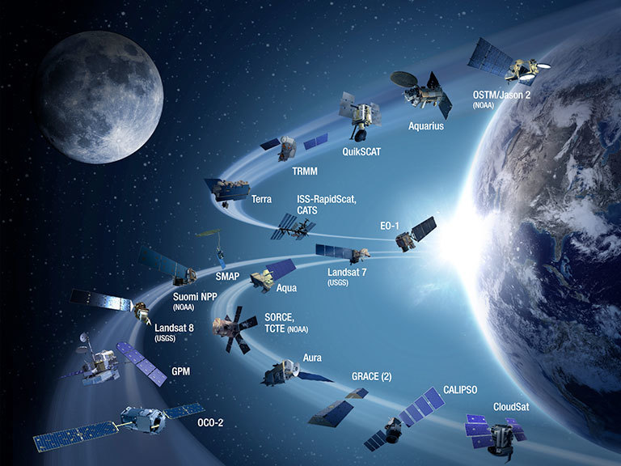
Most Common Optical Imaging Satellites
NASA Decadal Survey

Slide 5
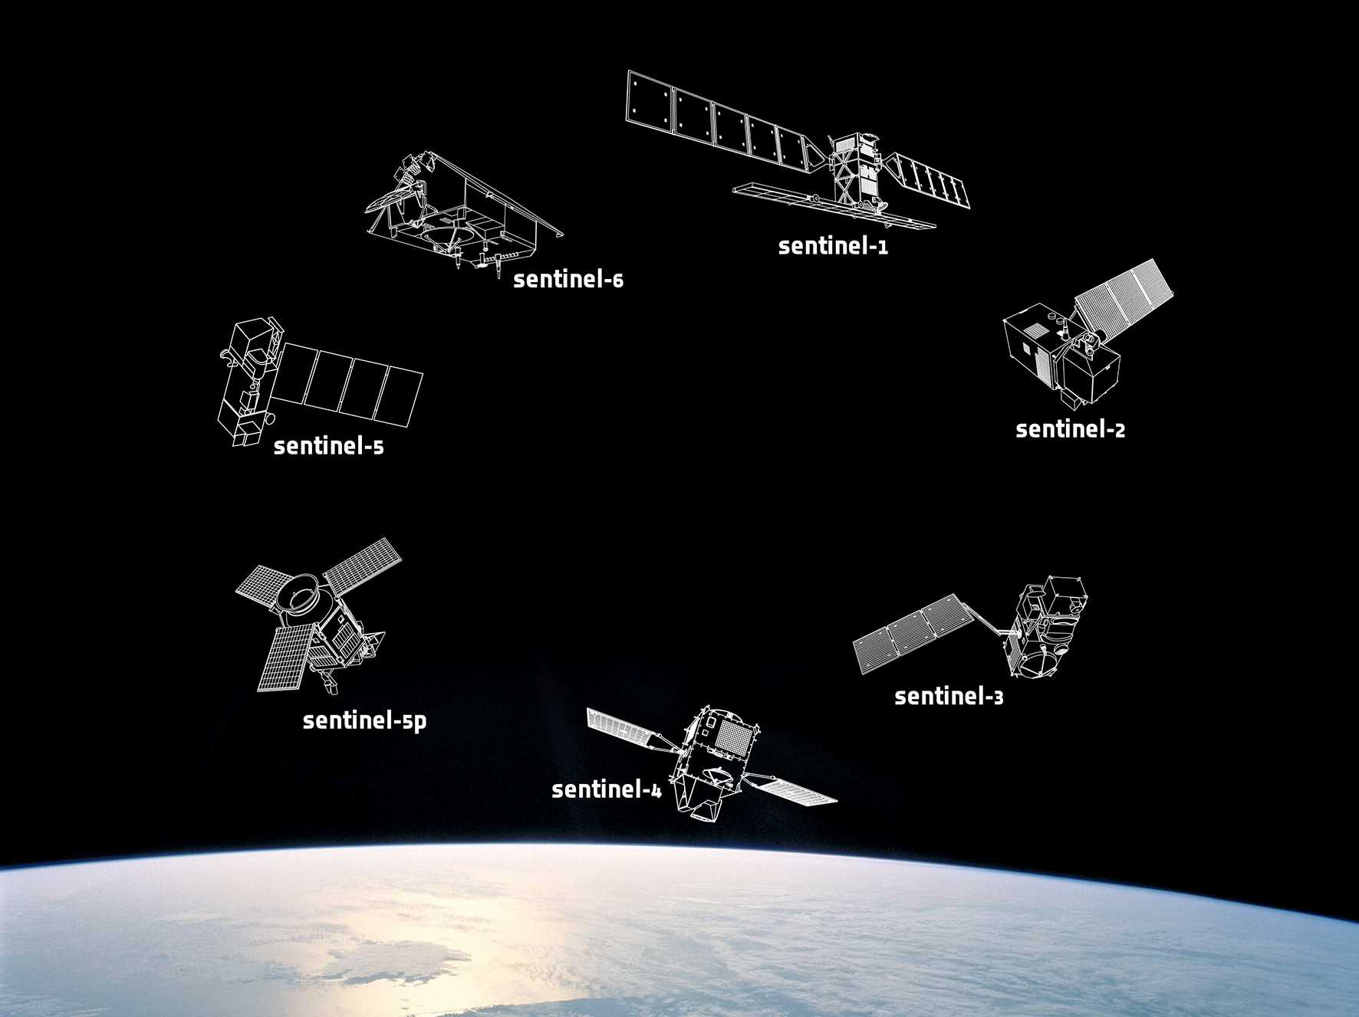
Most Common Optical Imaging Satellites
European Space Agency (ESA) Sentinel Missions

Slide 6
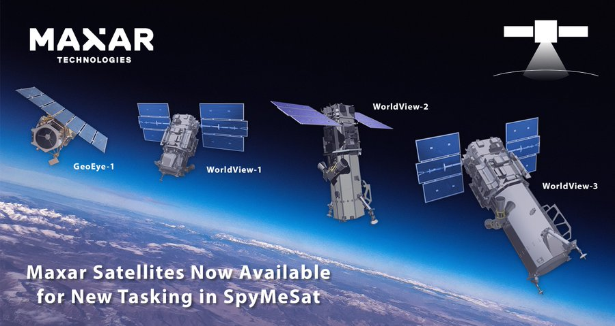
Maxar Commercial Satellites
A merger of Digital Globe and the former Canadian company, MacDonald Dettwiler Associates, that also owns RADARSat
Spymesat.com provides a cell phone app that allows users to purchase archived satellite imagery and request new imagery.

Slide 7
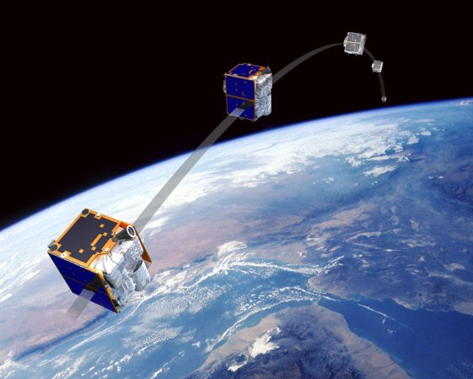
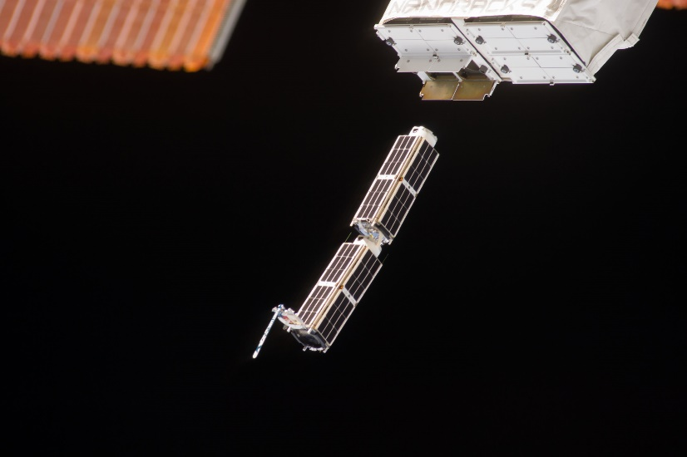
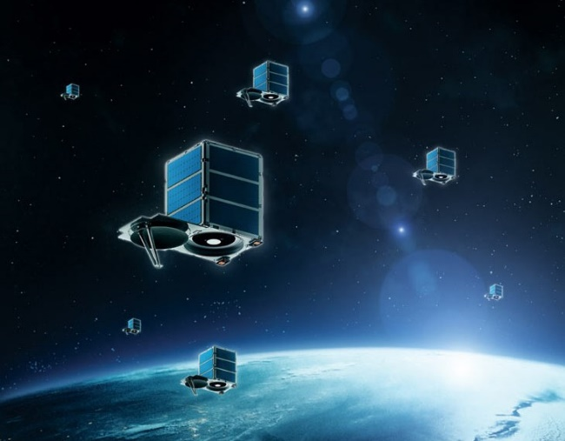
Planet Commercial Satellites
RapidEye
Dove
SkySat

Slide 8
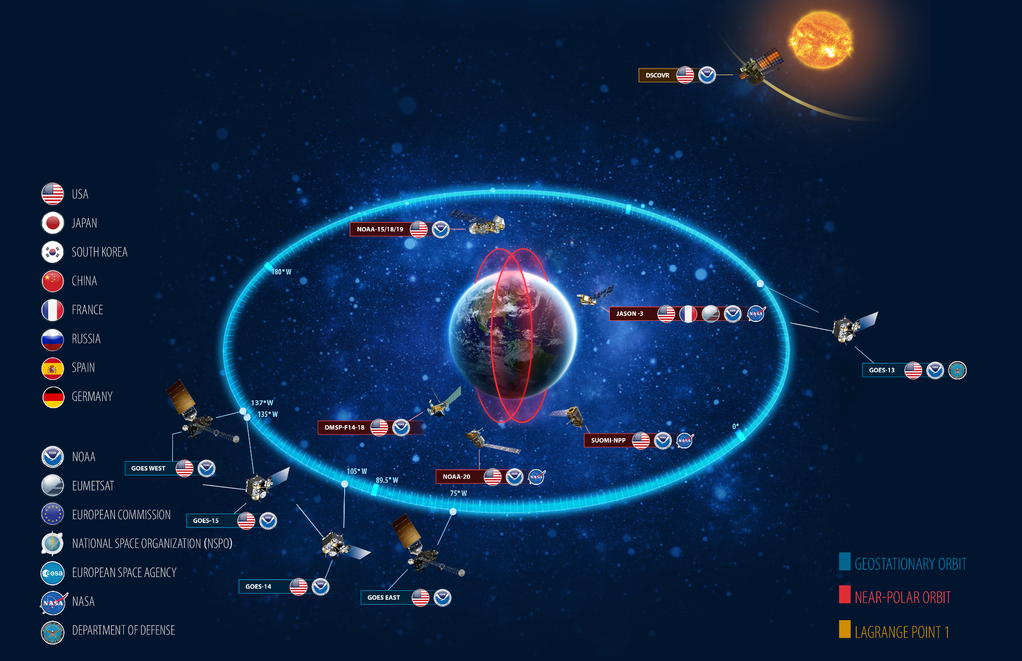
Weather Satellites Are in Both LEO and GEO Orbits

Slide 9
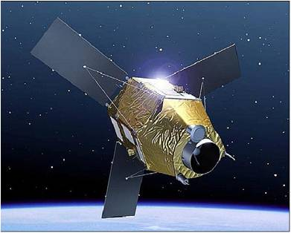
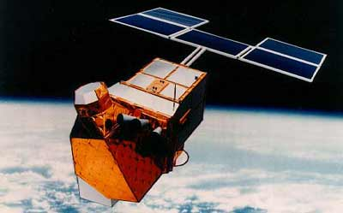
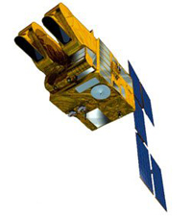
Just About Every Country Has Earth Imaging Satellites
France
Helios
Pan and Thermal IR
Pleiades
Pan and Multispectral
SPOT 1-7
Pan and Multispectral

Slide 10
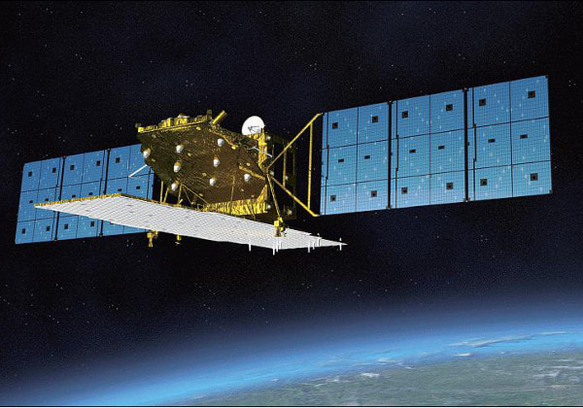
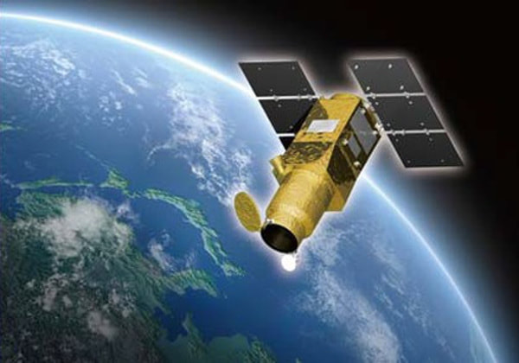
Just About Every Country Has Earth Imaging Satellites
Japan
ALOS 2
Synthetic Aperture Radar
ASNARO
Pan and Multispectral

Slide 11
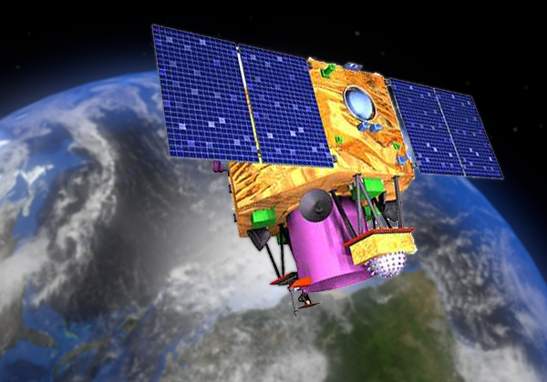
Just About Every Country Has Earth Imaging Satellites
India
CartoSat
Pan, Stereo and Multispectral

Slide 12
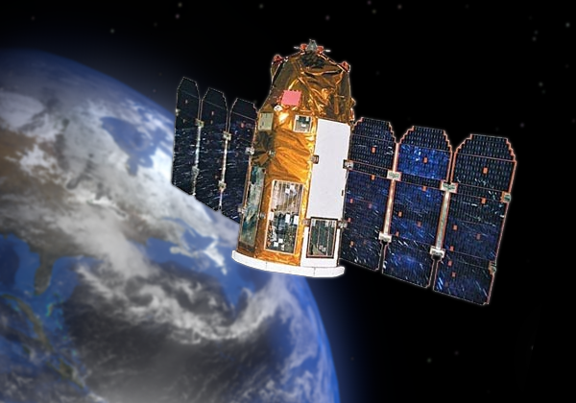
Just About Every Country Has Earth Imaging Satellites
Israel
EROS
Pan

Slide 13
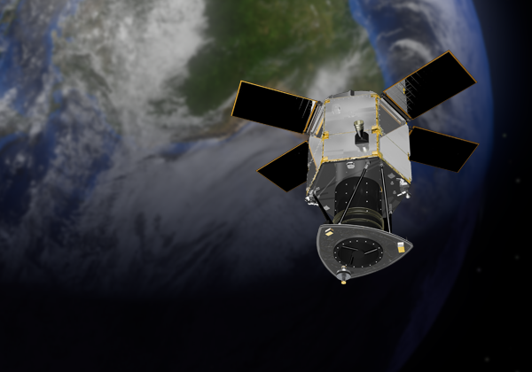
Just About Every Country Has Earth Imaging Satellites
Spain
DEIMOS
Pan and Multispectral

Slide 14
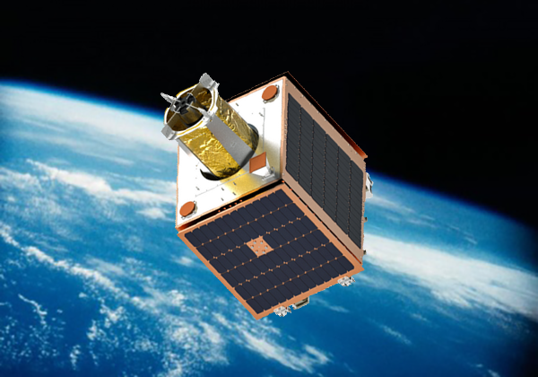
Just About Every Country Has Earth Imaging Satellites
United Kingdom
Carbonite
15 Satellite Pan Constellation

Slide 15
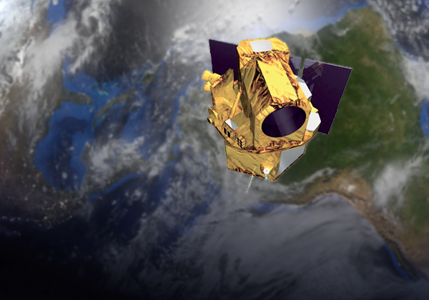
Just About Every Country Has Earth Imaging Satellites
Taiwan
FORMOSAT
Pan and Multispectral

Slide 16
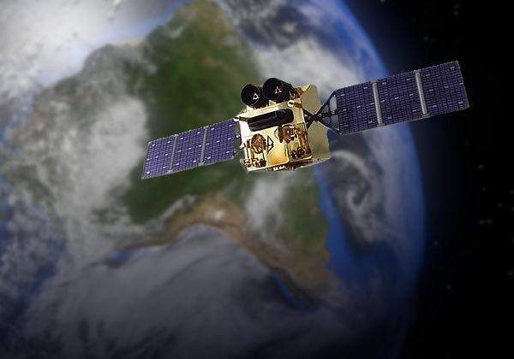
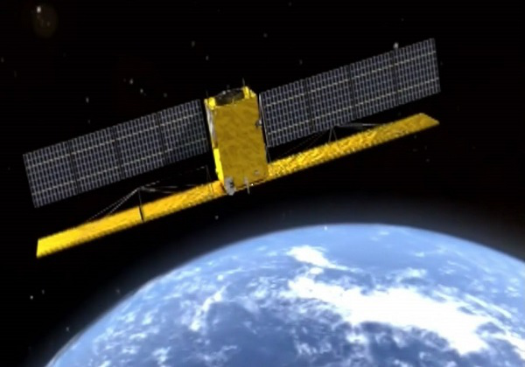
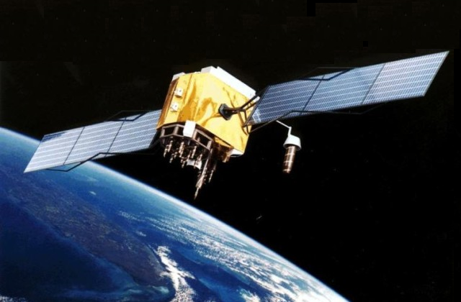
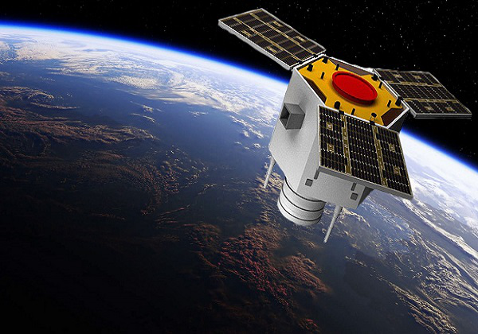
Just About Every Country Has Earth Imaging Satellites
China
Gaofen-1
Pan
Gaofen-3
SAR
Gaofen-2
Pan/Color
Jilin
Pan/Color
Note: There are reportedly 11 Gaofen satellites. Gaofen-5 launched in September 2021 with a hyperspectral imager.

Slide 17
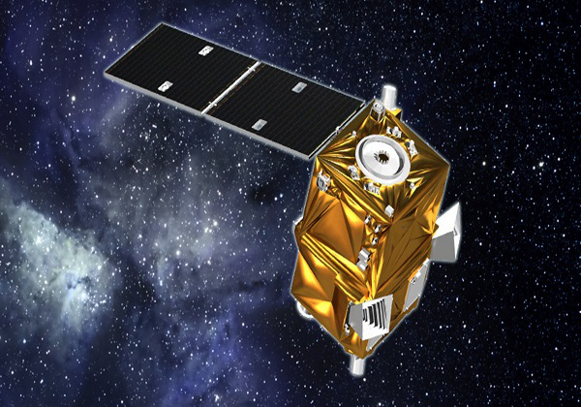
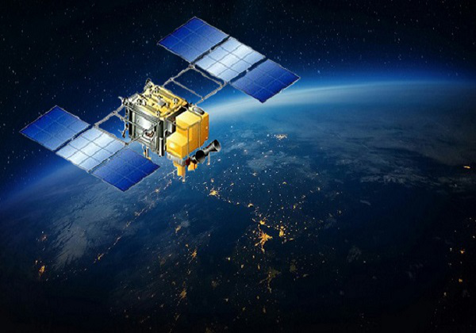
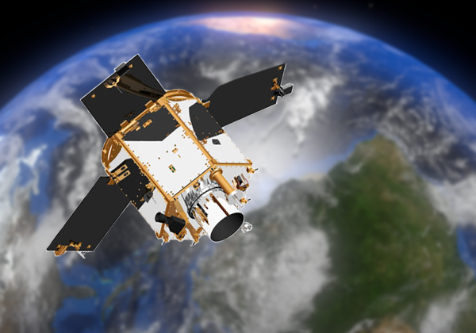
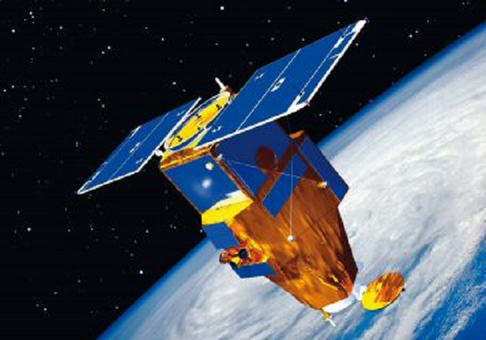
Just About Every Country Has Earth Imaging Satellites
Algeria
Belarus
UAE (DubaiSat)
Turkey

Slide 18
There Are More Low Earth Orbit Satellites Than You Can Count
https://platform.leolabs.space/visualization

Slide 19
All of These Have the Same Basic Characteristics
Motion/orbit
Cameras with physical limitations
  Optics
  Detectors and electronics
  Noise
Scan
Downlink and uplink data
Basic equations for design and performance

Slide 20
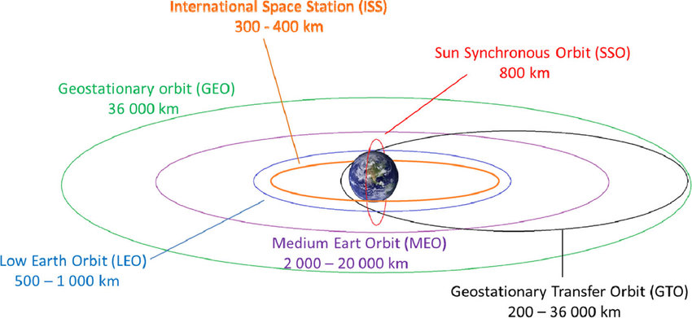
Types of Earth Orbits
Earth

Slide 21
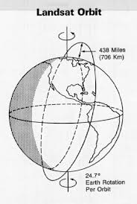
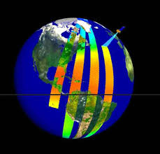
Sun Synchronous Polar Orbit

Slide 22
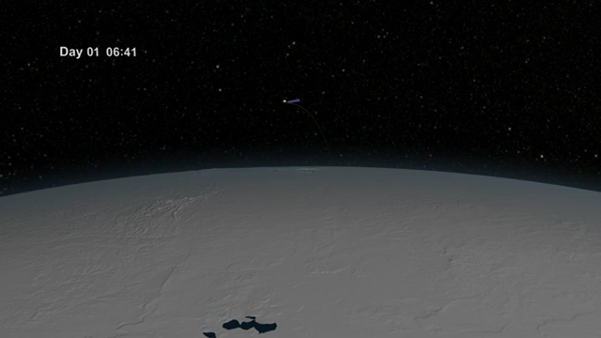
Landsat Orbit and Collection
You can watch near real time Landsat imagery on
http://earthnow.usgs.gov/earthnow_app.html?sessionId=709e6d7c39d5be172f99b318258941af50549

Slide 23

Low Earth Orbits

Slide 24
Parts of the Digital Camera
Optics
Sensor / Focal Plane / Detectors
Electronics

Slide 25
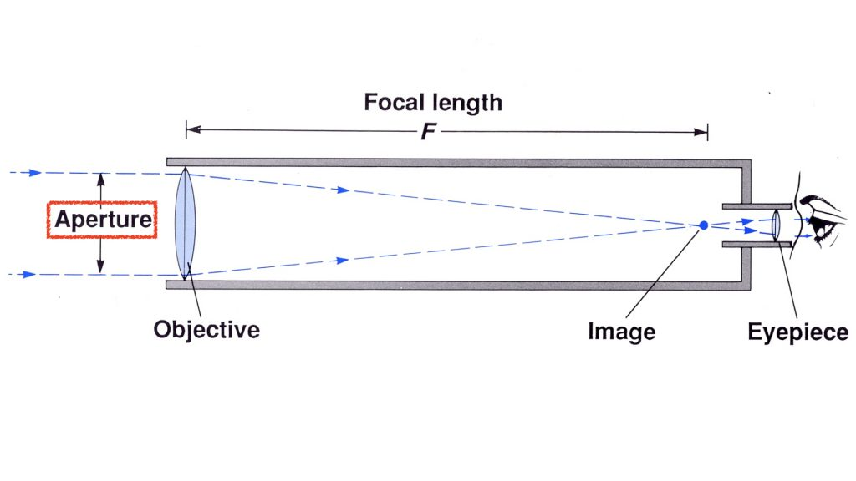
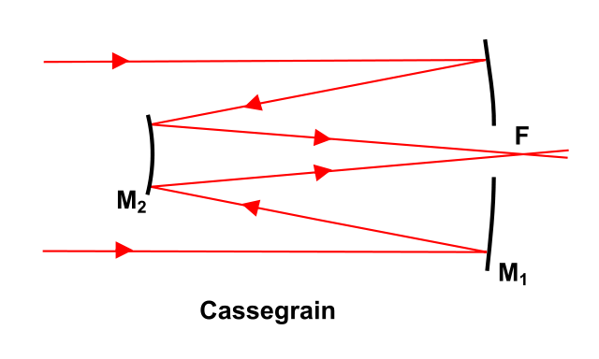
Basic Optics for a Camera
Refractive Optics
Detector Focal Plane
Read Out Electronics
Reflective Optics
This is how they squeeze big
optics into a small satellite

Slide 26
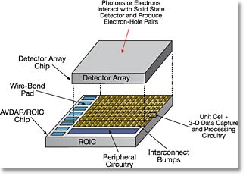
Detector Arrays Need a Read Out Integrated Circuit to Create Pixel Values

Slide 27

Each Detector Is Projected onto the Earth to Create a Single GSD
This is called “geometric optics”
Focal length
Similar Triangles
Aperture
GSD$=\frac{detector size ∙altitude}{focal length}$
Altitude/Distance to ground
Ground Sample Distance (GSD)

Slide 28
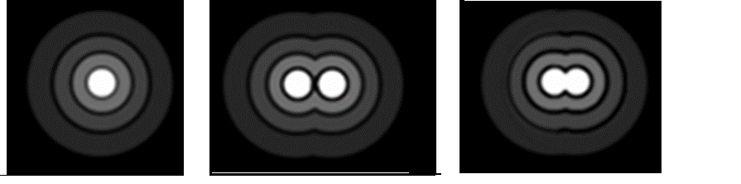
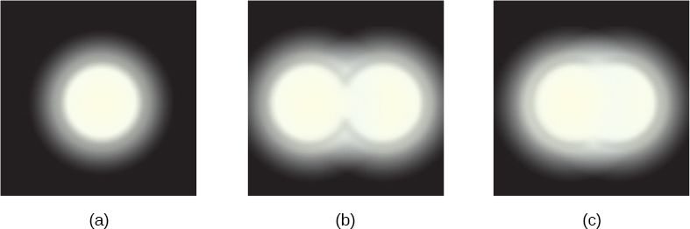

Geometric Optics Isn’t the End of the Story
The aperture creates a diffraction pattern that limits the sharpness of an image
The Point Spread Function (PSF) is a description of the minimum size and shape of point imaged by optics
A perfectly circular aperture creates an “Airy Disk”, sometimes called a blur circle
Blur Circle Diameter $≈wavelength ∙ f number$
One and two blur circles
with monochromatic light
One and two blur circles
with polychromatic light
The Rayleigh Criterion is the minimum separation distance where two points can be distinguished is called “resolution”
$$=\frac{1.22∗wavelength∗altitude}{aperture}$$

Slide 29
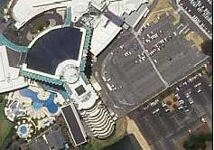

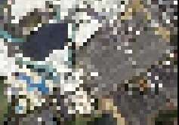
Always Pay Attention to the Relative Size of Resolution and GSD
Original Image:
Aperture and detector
sizes well matched
Aperture too small
Low resolution, small GSD
(Oversampled)
“Diffraction Limited”
Detector too large
High resolution, large GSD
(Aliased / Undersampled)
“Detector Limited”

Slide 30
Camera Optics Are Like Collecting Rainwater with a Funnel and Buckets
The bigger the aperture collecting area,
the more water is collected
The steeper the funnel angle (1/f#),
the more water is concentrated into
a small area (the blur circle.)
Aperture
The bigger the mouth of the bucket
(detector area), the more water can
be collected.
Focal
Length
The bigger the bucket (detector),
the more water (signal) is collected.
The speed at which the bucket is
emptied is the exposure or integration
time.
Detectors

Slide 31

Sensor Noise Creates Problems
Noise is the random variation of pixel outputs from detector to detector and time to time.
  More generally, it’s any signal from something other than the object of interest.
There are multiple types of random noise that affect pixels
  Dark Noise (N_{D}): Also called Read Noise. Standard deviation (σ) of number of electrons seen when no light impinges on the detector
  Photon (Shot) Noise (N_{P}): Poisson distribution variance (σ²) of number of electrons equals the average number of photo-electrons produced when light hits the detector
  Thermal Noise (N_{T}): Also called Johnson Noise and Dark Current Noise. Varies with the temperature of the electronics and the integration time.
Total Noise$=\sqrt{N_{D}^{2}+N_{P}+N_{T}(T)∙∆t}$

Slide 32
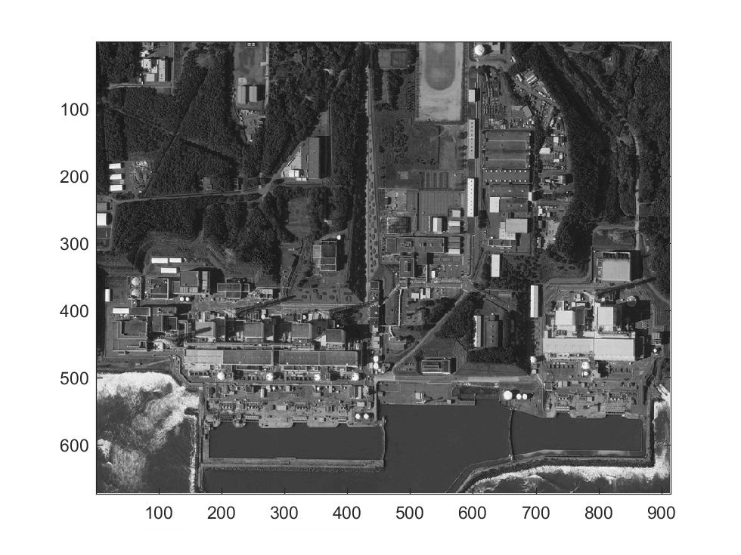
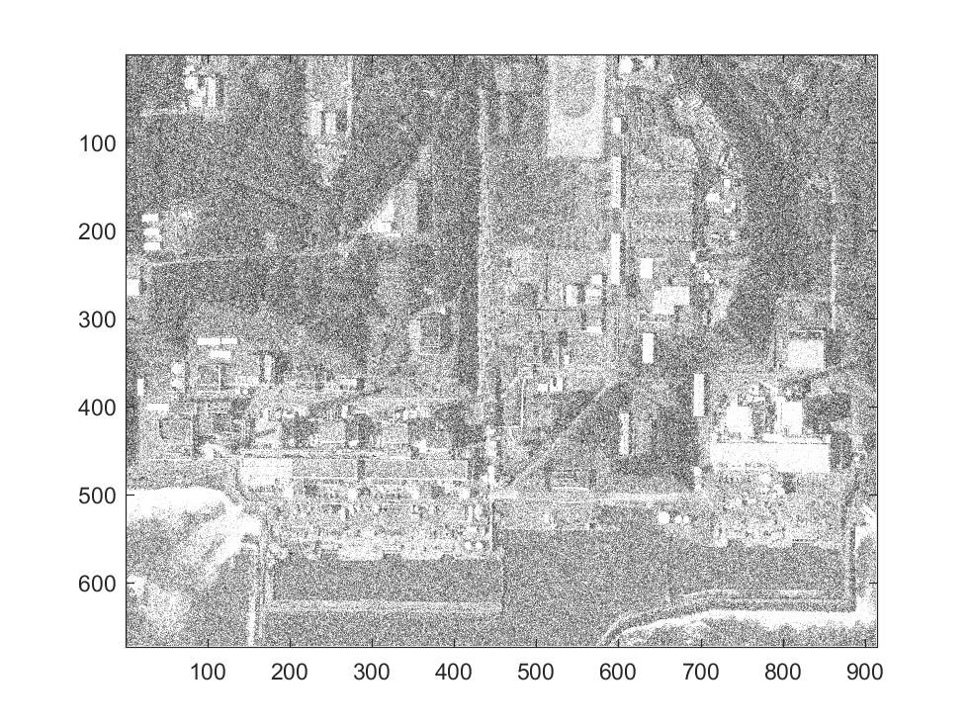
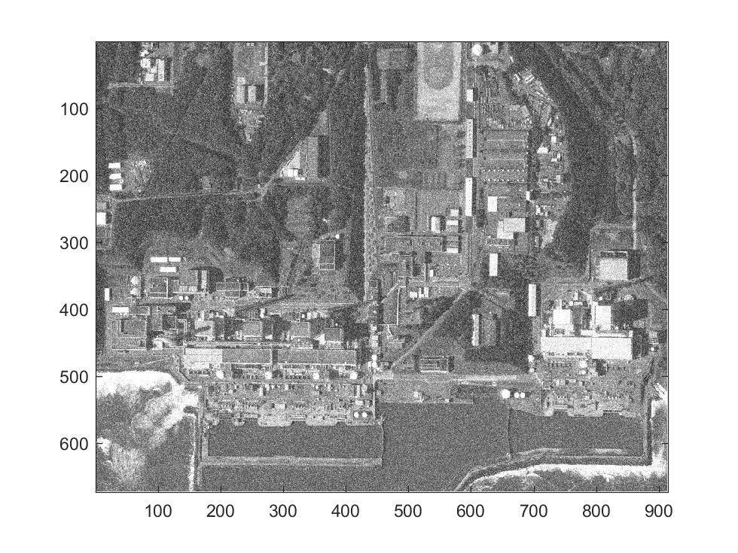
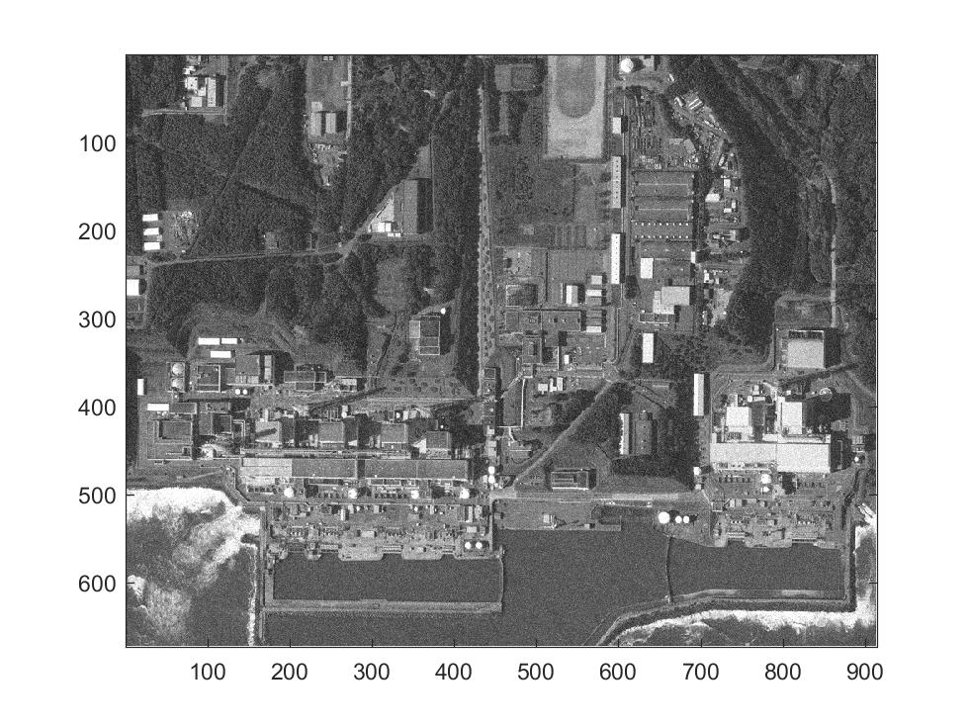
Noise Levels Significantly Change the Appearance of an Image
SNR=200
SNR=5
SNR=10
SNR=20
Signal to Noise Ratios of 5, 10, 20, and 200

Slide 33
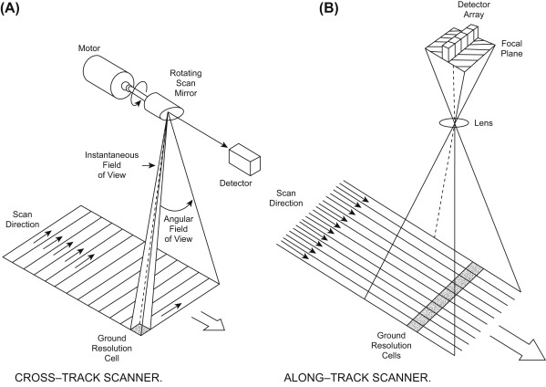
There Are Different Types of Scanning

Slide 34
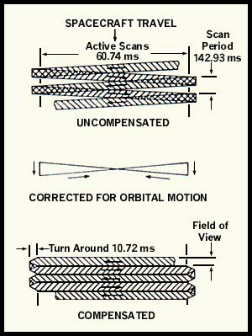
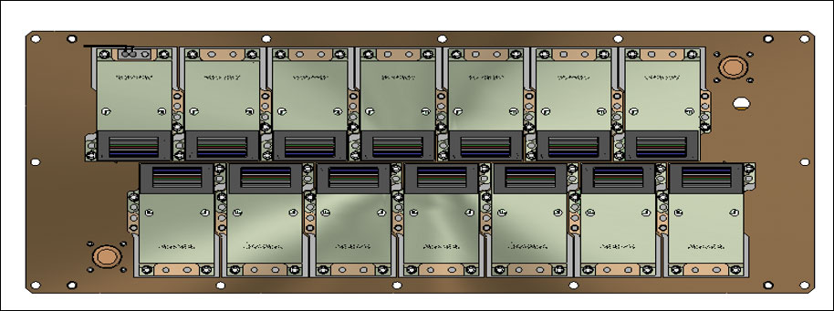

Scan Patterns
Whiskbroom Scan Pattern
Pushbroom
Scan Pattern
Landsat 4-7 (TM – ETM+)
Whisk Broom Scan Pattern
Smaller, more modern systems use
a 2D array for snapshots or
hyperspectral sensing.

Slide 35
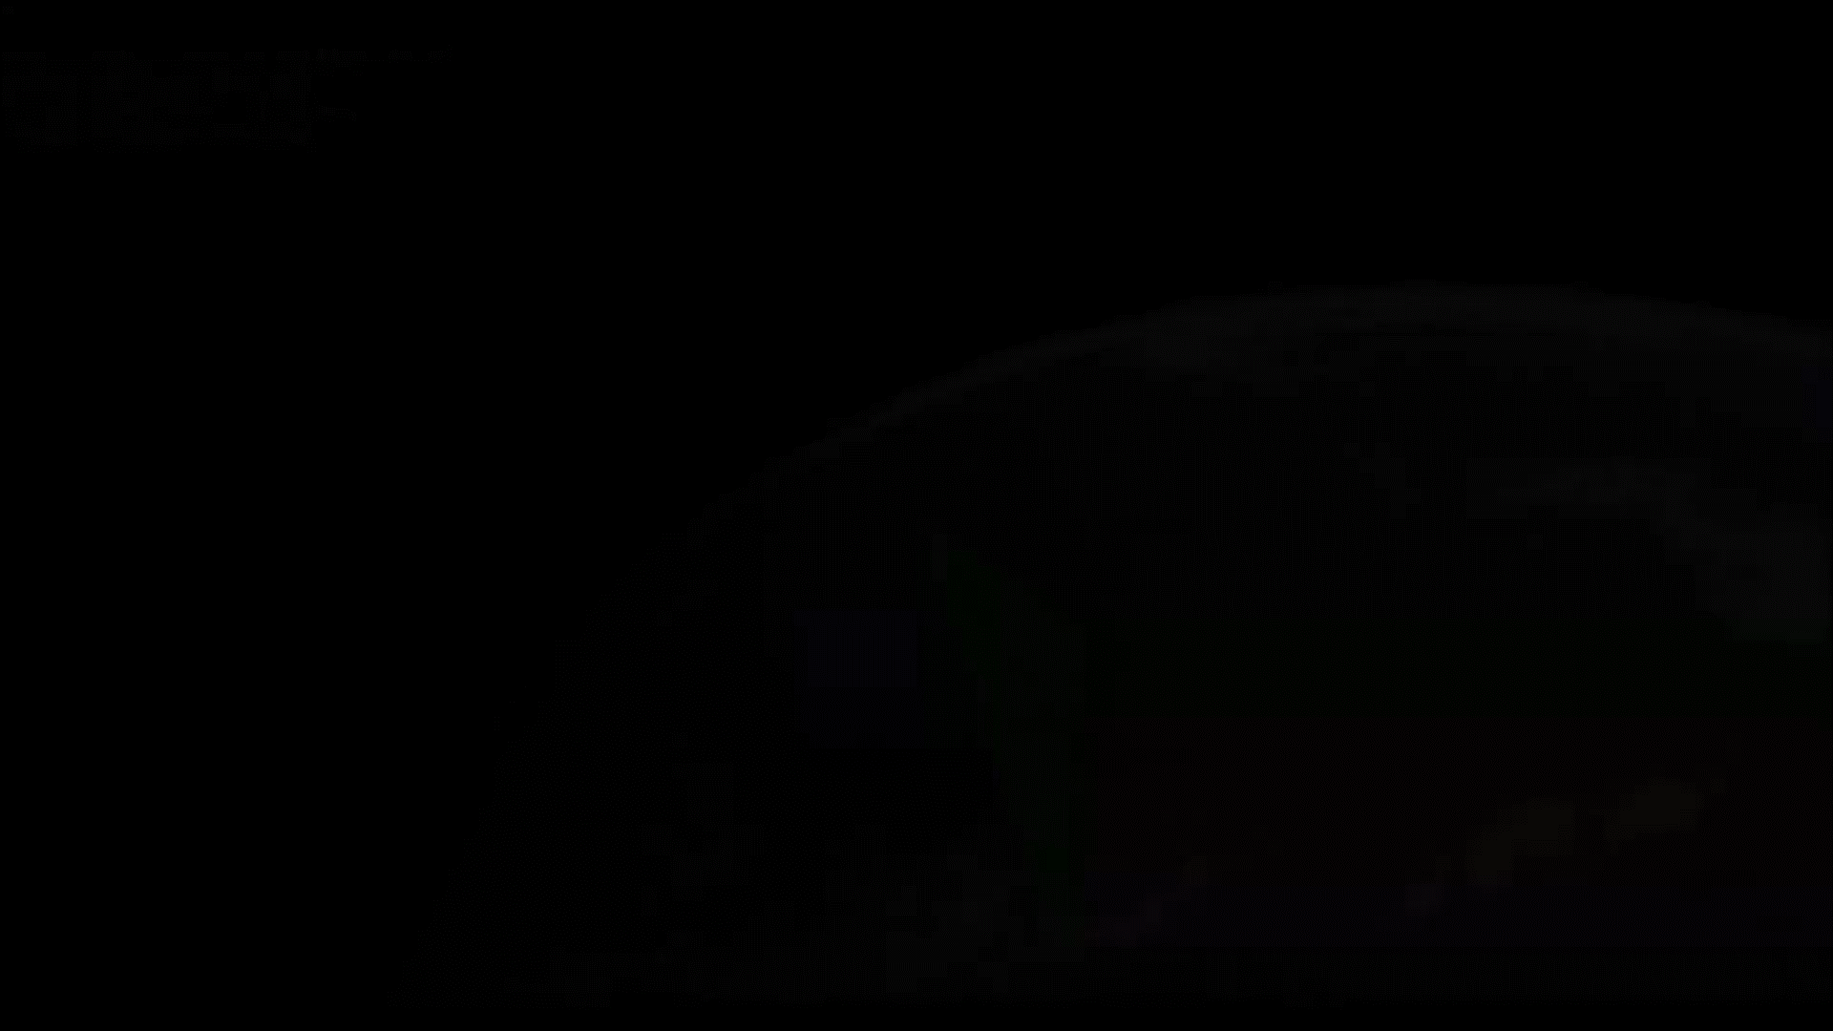
Many Satellites Rotate to Scan Points
on the Earth Not Directly Below Them
The action of changing the attitude and rotating of the satellite to scan the Earth is called “slewing.”

Slide 36
Imaging Satellite Communications
Uplink
  Relatively small amounts of data
  Commands and software updates
  Typically uploaded once per day
Downlink
  Much more data than uplink
  Image data, metadata and housekeeping
Because of high frequencies used and the amount of data, comm is limited to line-of-sight
  S Band typically used for uplink and downlink telemetry (2.1 GHz – 2.3 GHZ)
  X Band typically used for downlink of image data (7.25 GHz - 8.4 GHz)
  Satellite must be in sight of receiving/transmitting station
  Time within line-of-sight depends upon location of ground station and satellite orbit
    Ranges from seconds to minutes
    The more ground stations, the more data can be sent
  Data to be downloaded stored on-board until within sight of station
  Some Government satellites send data through on-orbit relay satellites to ground stations
    Provides more frequent access to ground stations

Slide 37
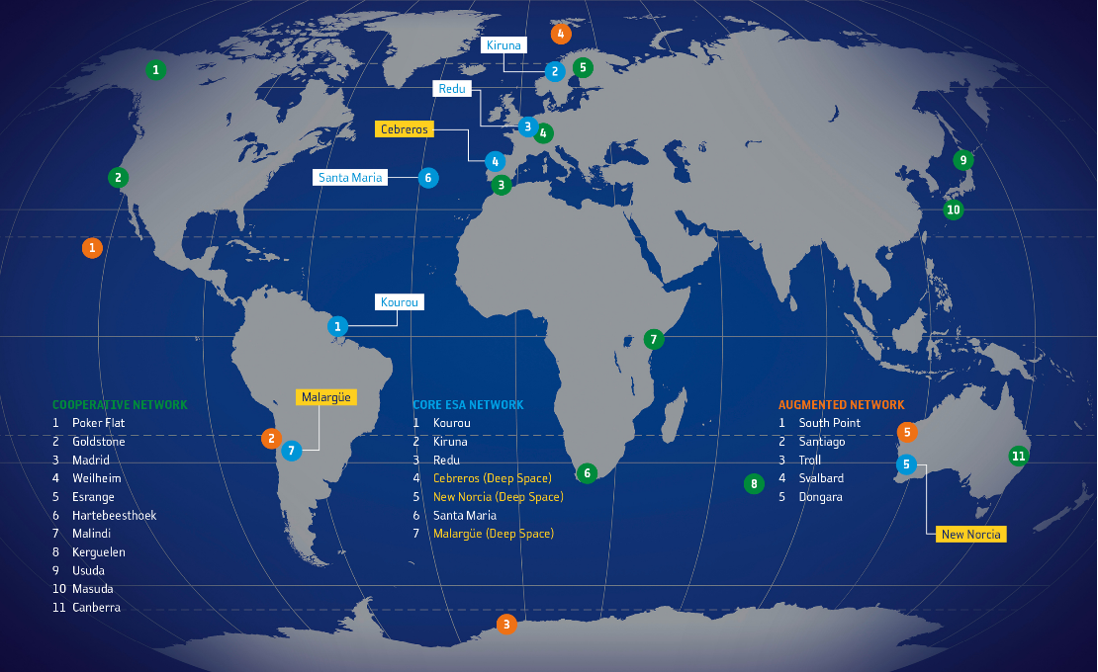
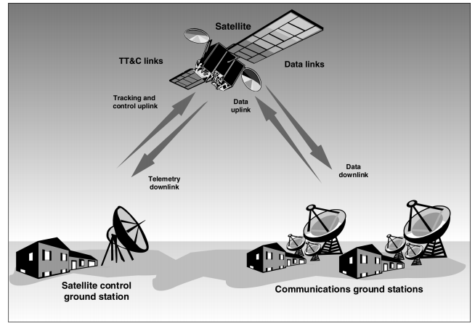
Ground Stations
Multiple commercial and private ground stations are available throughout the world
  Many are located close to the poles for access during multiple orbits of sun sync satellites
  All are capable of downlinking and uplinking data
Communications are limited to line-of-sight
  Maximum connection time is typically less than 7 minutes
European Space Agency Ground Stations

Slide 38
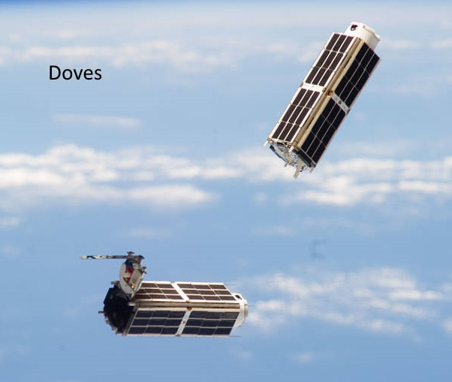







Imaging Satellites Come in All Shapes, Sizes and Capabilities

Slide 39
Comparison of Different Imaging Satellite Characteristics
Satellite | Imaging Sensor | Sat. Mass | GSD | Image Area | Spectral Bands | Revisit Time | No. of Sats | Altitude
Aqua/Terra | MODIS¹ | 3117kg | 250m - 1000m | 2330 km across | 36 | 1 - 2 days | 2 | 705km
Joint Polar Satellite System (JPSS) | VIIRS | 2930kg | 750m | 3000 km across | 22 | Global every day | 2 | 830km
Landsat | OLI/TIR | 2780kg | 30m | 185kmx180km | 8 - 11 | 8 days | 2 | 705km
Sentinel-2 | MSI | 1200kg | 10/20/60m | 290km across | 13 | 5 days | 2 | 786km
Skysat |  | 110kg | 0.9 - 2.0m | 1.1kmx2km | BGRN/Pan | 8 hours | 13 | 500km
Planet |  | 5kg | 3.2m | 20kmx12km | BGRN | 1 day | 175 | 400 - 475km
Worldview 3 |  | 2800kg | 0.31m/1.24m/3.7m/30m | 13.1km across | Pan/8 VNIR/8 SWIR/12 ATM | <1 day | 1 | 620km
MUSES² | DESIS | 88kg | 30m | 30km x 30km | 235 | <1 day | 1 | 400km
1 Aqua, Terra and JPSS carry multiple instruments
2 MUSES is not a satellite, but a platform on the International Space Station

Slide 40

MODIS (Terra) Image of Great Lakes
GSD = 1 km; Cross track width = 2330 km

Slide 41

Advanced Baseline Imager (ABI) on GOES-17 Geo Sat of Caldor Fires
GSD ≈ 1 km; Frame spacing = 5 minutes

Slide 42

JPSS VIIRS Day Night Band
Image of Bioluminescence
Java
“Milky Sea”
GSD = 750 m

Slide 43

Sentinel-2 Image of Philadelphia
GSD = 20m

Slide 44


Videos from Skysat
GSD = 1.1 m

Slide 45

Very High Resolution Worldview-3 Image
GSD = 0.31 m

Slide 46





Instrument Designs Are Always a Compromise Between GSD, Ground Area and Other Characteristics
Multiple images of same area of Brazil at different resolutions
Notes:
Spatial and Temporal Resolution
Spatial resolution refers to the size of one pixel on the ground. For example 15 meters means that one pixel on the image corresponds to a square of 15 by 15 meters on the ground. This is also sometimes referred to as Ground Sample Distance (GSD). Temporal resolution refers to the how often data of the same area is collected. This is typically referred to as Revisit Time.
Sensors can trade spatial resolution for temporal resolution, but it is difficult to maximum both. Sensors that have a high spatial resolution cover a smaller area then a sensor with the same number of pixels but with a lower spatial resolution. With a smaller field of view it takes longer to cover the same area, thus as spatial resolution increases, temporal resolution decreases.
Freely available imagery (e.g., Landsat, Sentinel, MODIS) tends to either have a revisit time measured in days (1-4 days) with resolution in the hundreds of meters (300m-500m), or a revisit time measured in weeks (10-20 days) with resolutions in the tens of meters (10m-30m).
High resolution commercial imagery is available up to .3m resolution, with revisit times varying quite a bit. Some sensors are tasked, or pointed to collect specific areas rather than always just collecting the area directly below. As a result, some areas may not be covered at all by tasked satellites. While there is still a premium for the highest resolution imagery (<0.50m), medium to low resolution is suitable for many applications, and increasingly affordable or available at no cost.
Pansharpening
Some sensors take images of lower resolution in many bands (e.g. Multispectral red, green and blue for a color image), and then have another channel with much wider spectral range (i.e. “panchromatic”) with finer resolution. By means of a mathematical relations, it is possible to increase the resolution of the multispectral bands with the higher resolution panchromatic band. Pan-sharpened imagery doesn’t add information but can be useful for images that are primarily for human viewing purposes.
Accuracy
Accuracy refers to the possible difference between the reported locations on the images and their actual location in the real world. A usual standard is a 90% likelihood within a Circular Area around the location (CE90). To ensure accuracy, satellite images are ortho-rectified for orography with either an elevation model, or using Ground Control Points (GCP).
What spatial resolution do I need?
The imagery samples below can help select the right imagery for your project. In an urban environment like Fortaleza, free pan-sharpened Landsat imagery (15m) shows the extent of the city. Medium resolution imagery like RapidEye (5m) shows roads. With Worldview 3 (.3m) and Pleiades (.5m) images you can count beach umbrellas.

Slide 47
Why Don’t We Always Collect the Highest Resolution Images?
Mission objectives, physics and engineering limitations constrain the satellite/instrument design.
Onboard storage and download rates constrain number of pixels/image, number of images/time period and number of bits/pixel.
  Example: 400 images/day x 6000 x 6000 pixels x 12 spectral bands x 10 bits/pixel x 0.6 compression rate / (240 seconds/window x 14 windows/day) = 309 Mbps
Image noisiness and sensitivity (SNR) constrains f-number (focal length / aperture size) and detector size.
Revisit time drives image area, orbit and number of satellites
Size of image area drives the number of detectors and exposure time.
Orbit and altitude can drive exposure time.
GSD drives detector size, focal length and altitude.

Slide 48
Example of Basic Instrument Design
Start by setting the system requirements
  GSD = 1m
  SNR = 130
  Orbit altitude = 500 km
  Scene radiance level = 9.7E19 photon/s-m²-steradian-um
  Spectral band = 0.45 - 0.51 um (blue band)
Select available hardware that requires least customization
  Detector chip: 7.2um detector size
  Quantum efficiency=0.8 electrons/photon
  Dark noise=100 electrons
  2D staring array like those in consumer cameras
    Frame rate=120Hz (1/frame rate = exposure time)
Run these values through some simple equations.

Slide 49





Simple Algebra Tells You What the Instrument Will Look Like
These equations apply to any camera from microscopes to telescopes, from cell phones to the James Webb Space Telescope.
$$λ=0.48μm$$

Slide 50

It Doesn’t Take a Fancy Satellite to Capture Great Remote Sensing Shots
Photo taken 6/6/2021 by Thomas Pesquet, a French astronaut on the ISS, with a
Nikon D5, F#8, 1.15m focal length, 1/4000 second exposure

Slide 51

A Simple Spreadsheet Can Help to Design an Imaging Satellite
Rules of Thumb:
SNR>50
Dark noise: 3 to 100 electrons
Detector Size: 3um to 50um
Integration Time: 0.0001 to 0.1 seconds
Altitude > 450 km
Quantum Efficiency: 0.6 to 0.95 electrons/photon
Radiance: 9.6E19 ph/s-m²-ster-um for color, 1.2E20 ph/s-m²-ster-um for pan
Bandwidth: 15% of wavelength for color, 50% for pan
F-number: 4 to 22
Resolution < 1.2 x GSD

Slide 52
All Right, So It Isn’t Quite That Simple
Several parameters have values that vary across the spectrum of interest.
  Scene radiance, optical transmission, quantum efficiency, etc.
Dark noise may have a thermal component.
  Thermal components are usually only important for IR cameras.
Focus and distortion may degrade with distance from center of the detector array.
Scanners must take into account ground speed and slew speed of satellite.
Satellites still need room for other subsystems like power, communications, processing, data storage, attitude control, shielding, etc.
  All of these require less volume than the imaging instrument.
Still, the equations will provide a good first estimate of size.

Slide 53
Any Questions?

